Slide 1
British Airways Review Data Analysis using SQL
Kaggle Link: https://lnkd.in/gzkq7xRG

Slide 2
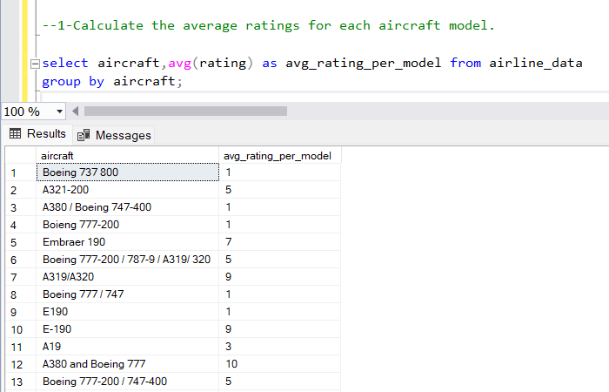
Calculate the average ratings for each aircraft model.

Slide 3
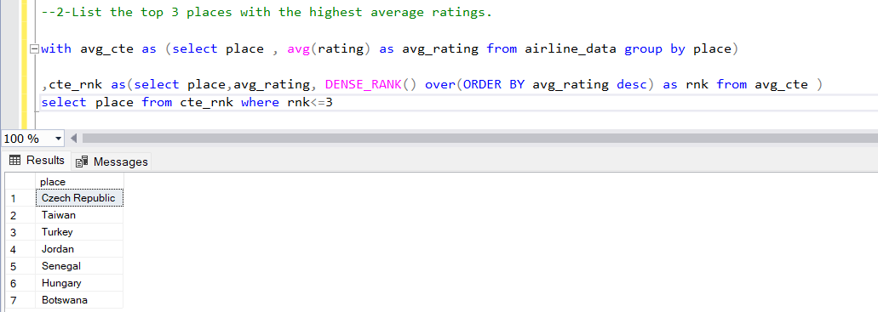
List the top 3 places with the highest average ratings.

Slide 4
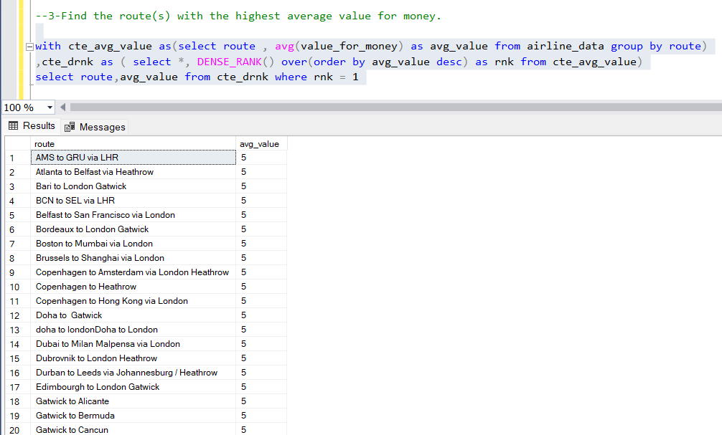
Find the route(s) with the highest average value for money.

Slide 5
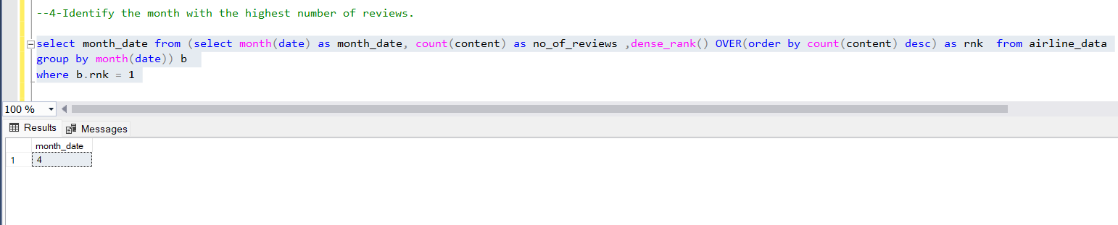
Identify the month with the highest number of reviews.

Slide 6
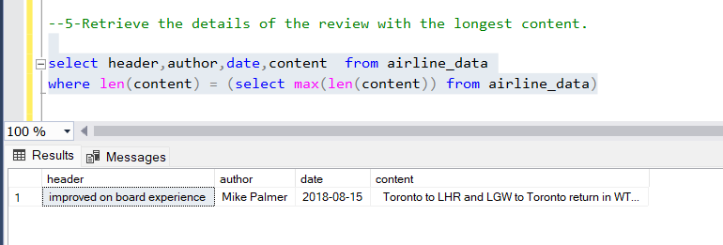
Retrieve the details of the review with the longest content.

Slide 7
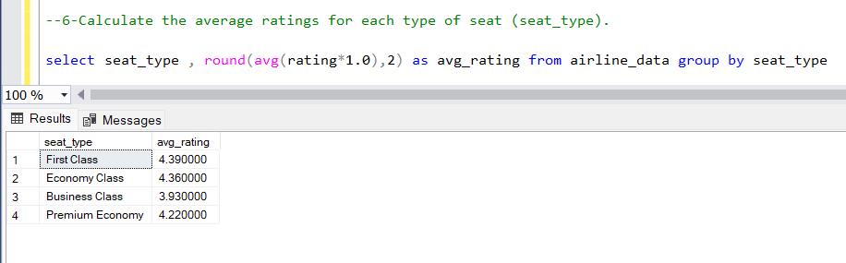
Calculate the average ratings for each type of seat (seat_type).

Slide 8
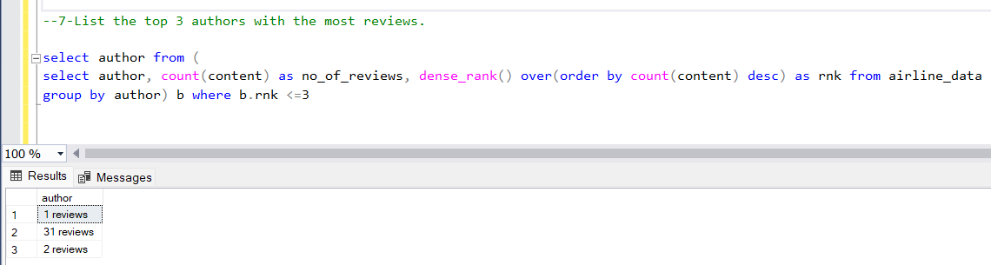
List the top 3 authors with the most reviews.

Slide 9
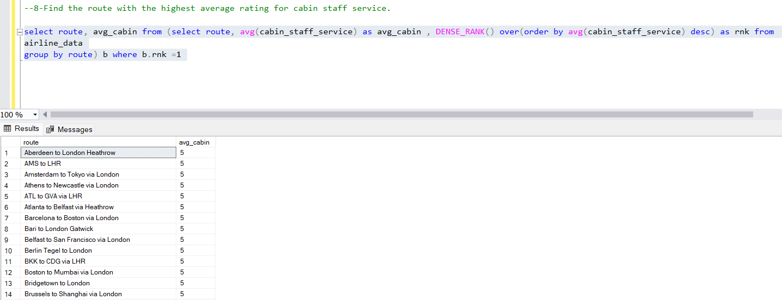
Find the route with the highest average rating for cabin staff service.

Slide 10
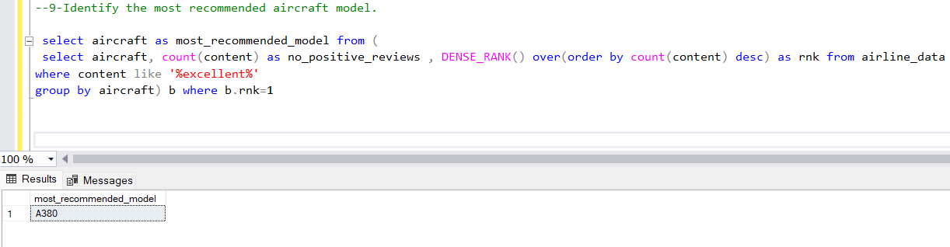
Identify the most recommended aircraft model.

Slide 11
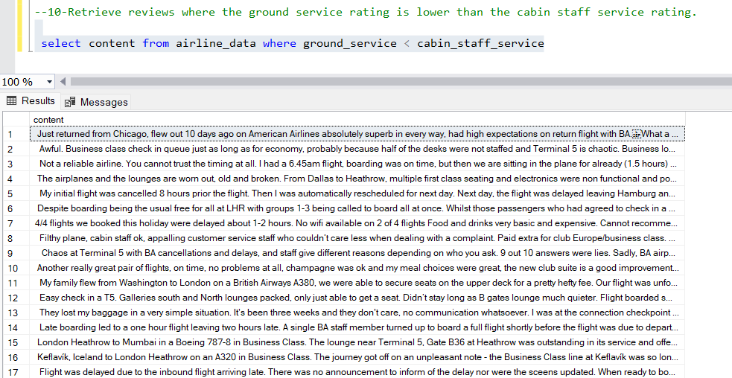
Retrieve reviews where the ground service rating is lower than the cabin staff service rating.

